Slide 1
BMP Maintenance Guide
Andi Hodaj & Allison Turner
20 May 2015

Slide 2
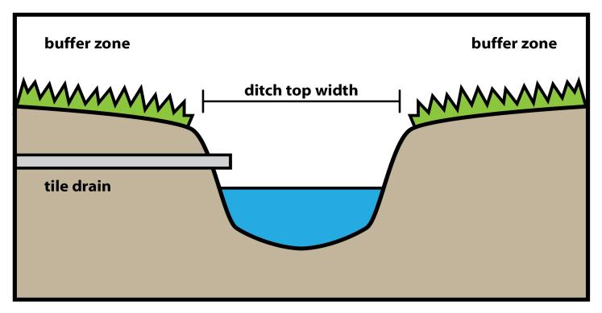
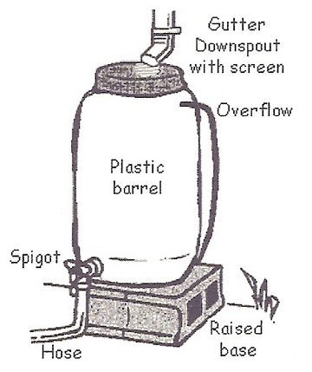
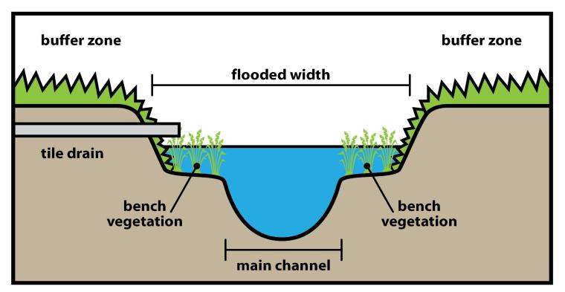
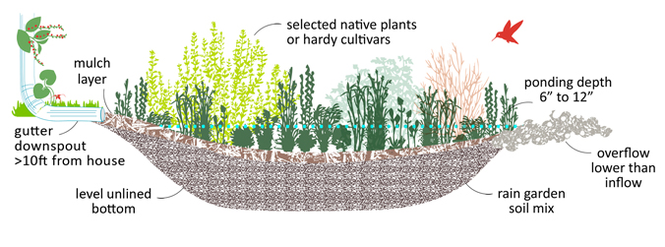
What’s the purpose?
Traditional ditch
Two-stage ditch
Notes:
Allison: the designs are here to show that these practices are complex! Once they are installed, they will require some maintenance, and it is important for homeowners to know how to correctly maintain these carefully designed practices. If they aren’t maintained properly, they will not have the optimal watershed benefit. Andi: In addition, we wanted to show that the maintenance required for these BMPs is simple and does not require too time or resources.

Slide 3
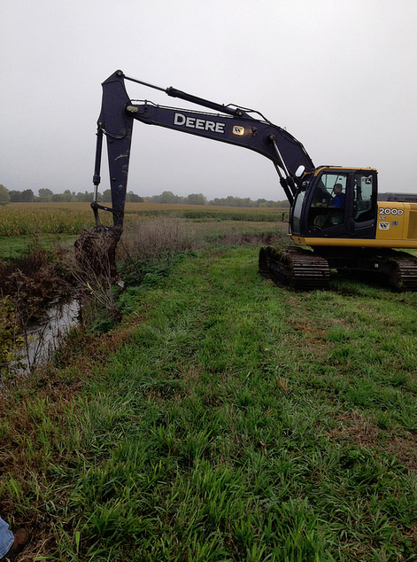
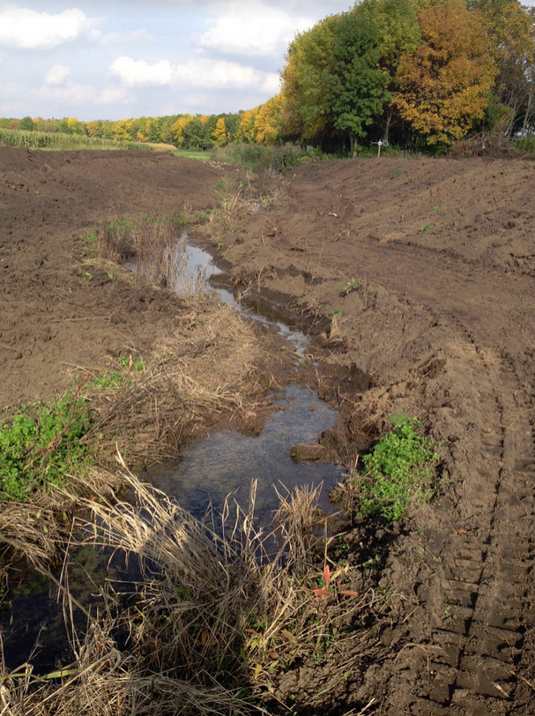
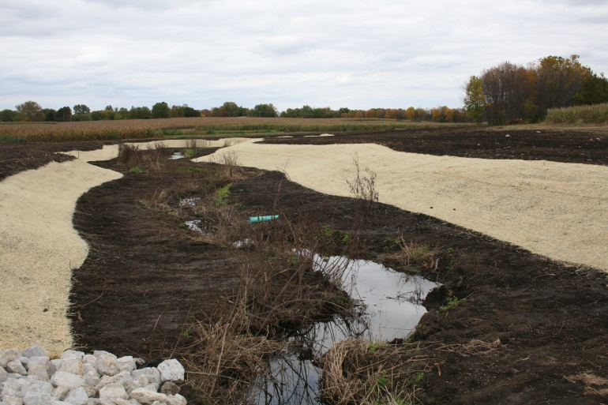
Two-stage ditch
Constructed bench
Main channel
Initial cost varies from $10 - $68 per linear foot of two-stage channel

Slide 4
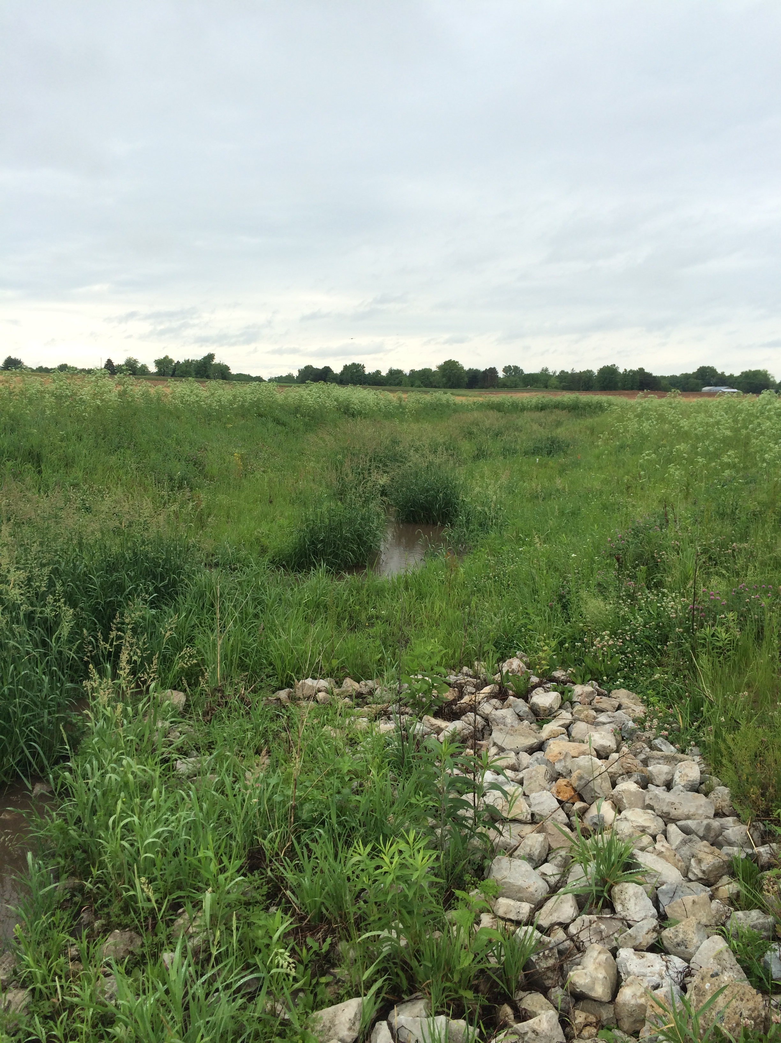
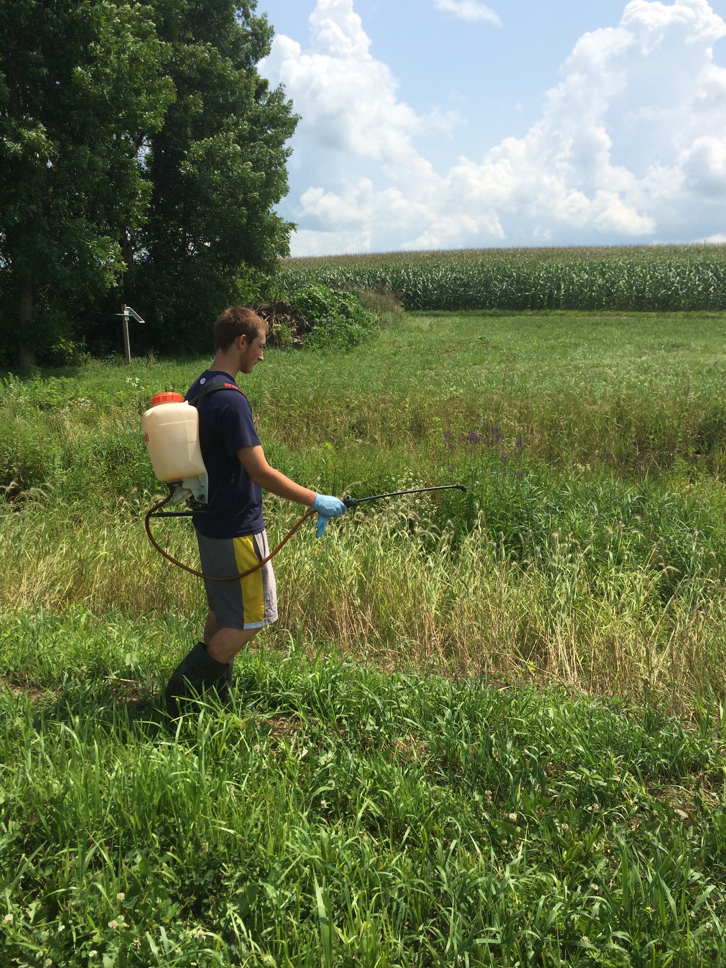
Two-stage ditch maintenance
Periodical inspections
Re-seeding the benches
Spraying noxious or invasive plants
Mowing the benches periodically
Controlling spread of woody vegetation
Keep tile drain outlet pipes open and protected

Slide 5
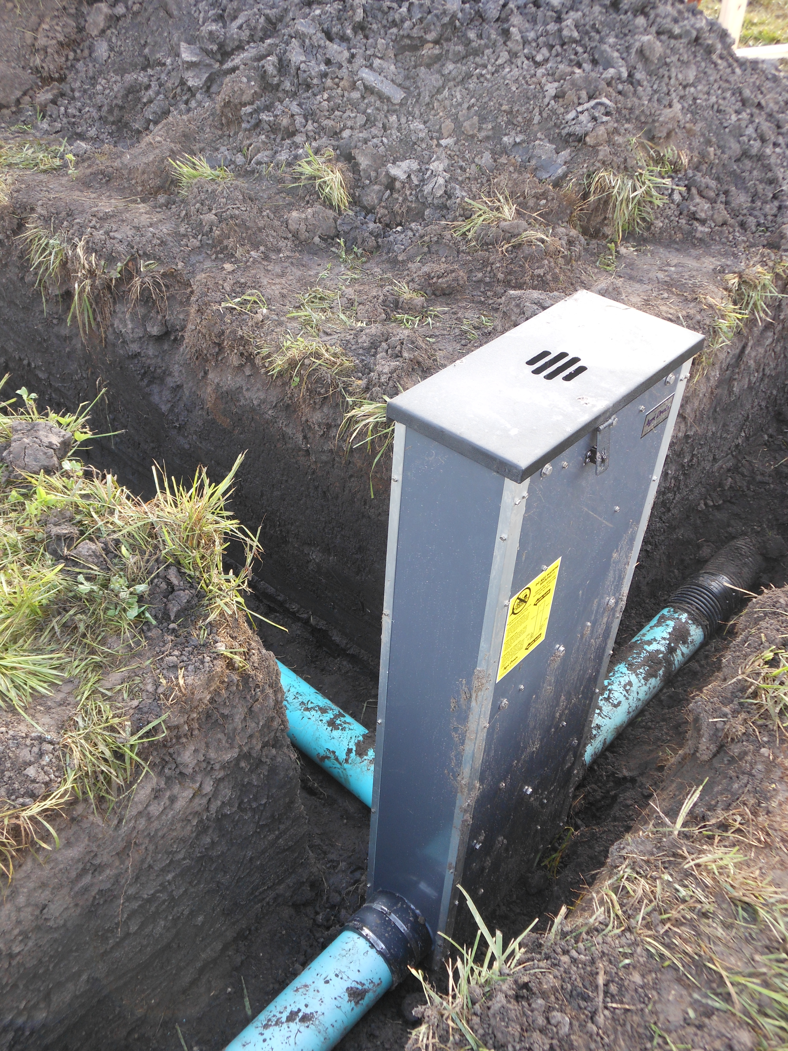
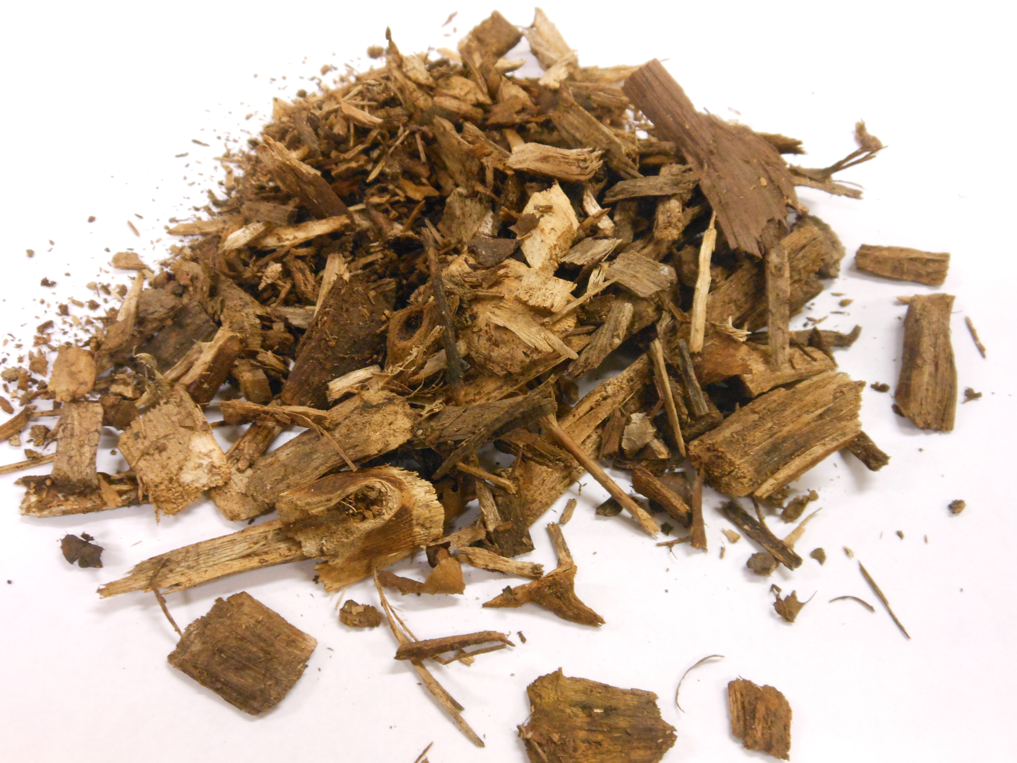
Denitrifying bioreactor
Initial cost varies from $4,000 - $12,000 treating drainage area between 30 – 100 acres

Slide 6
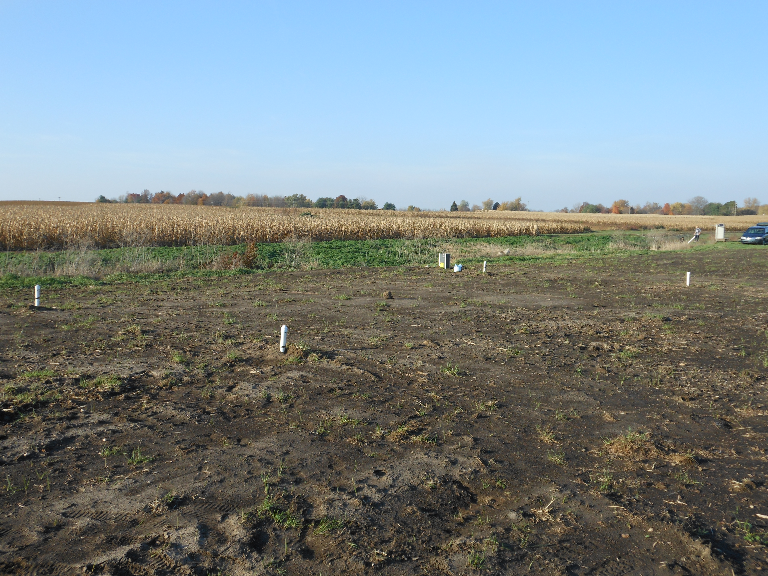
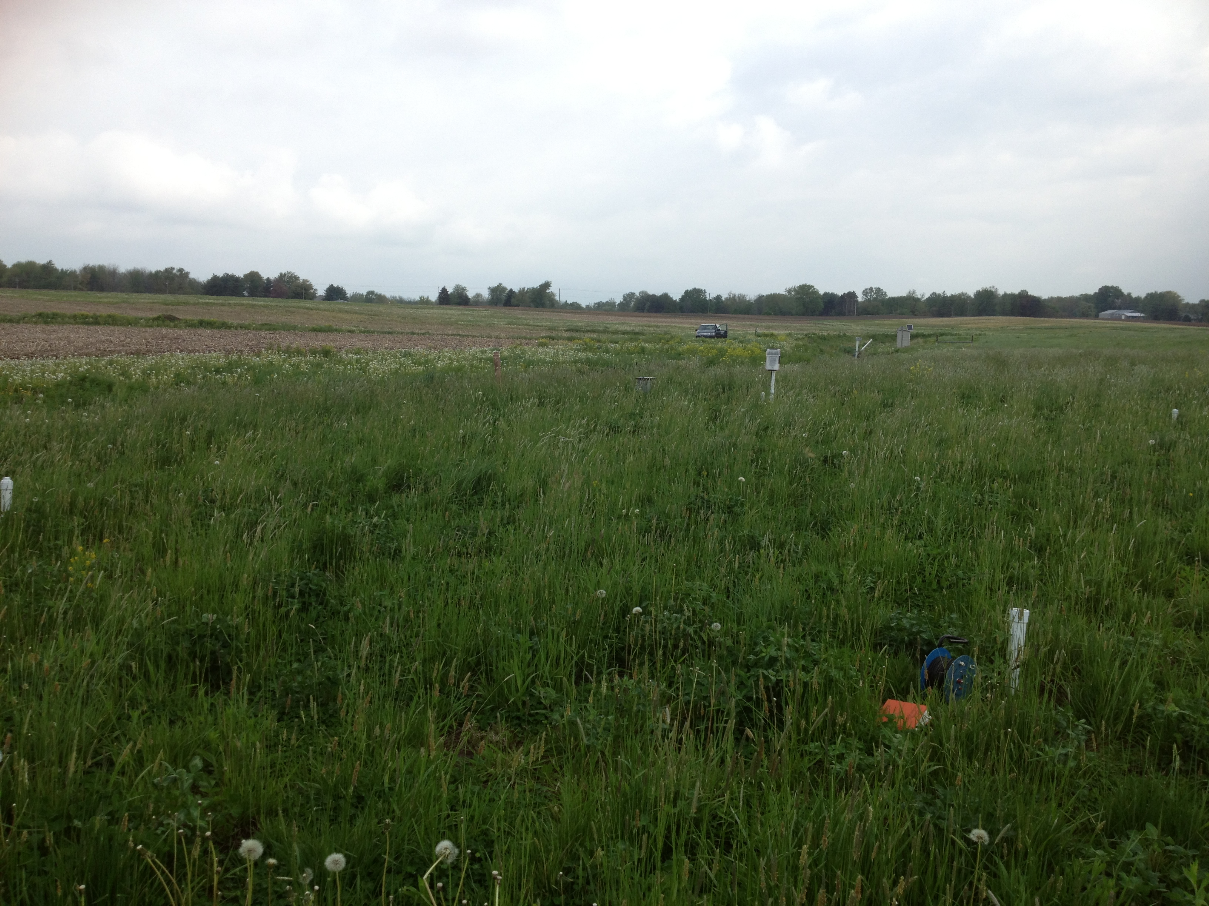
Denitrifying bioreactor maintenance
Woodchip replacement (every 10 years approximately)
Periodic mowing (same as a buffer strip)
Periodic inspections of the control structures
Re-seeding if needed

Slide 7
Vegetated filter strips
Initial cost consists of taking some land out of crop production

Slide 8
Vegetated filter strips maintenance
Periodic mowing
Re-seeding or inter-seeding
Spraying to control spread of invasive species
Fertilizer application if necessary

Slide 9
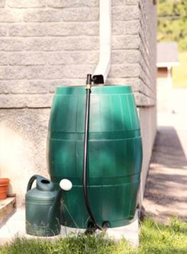
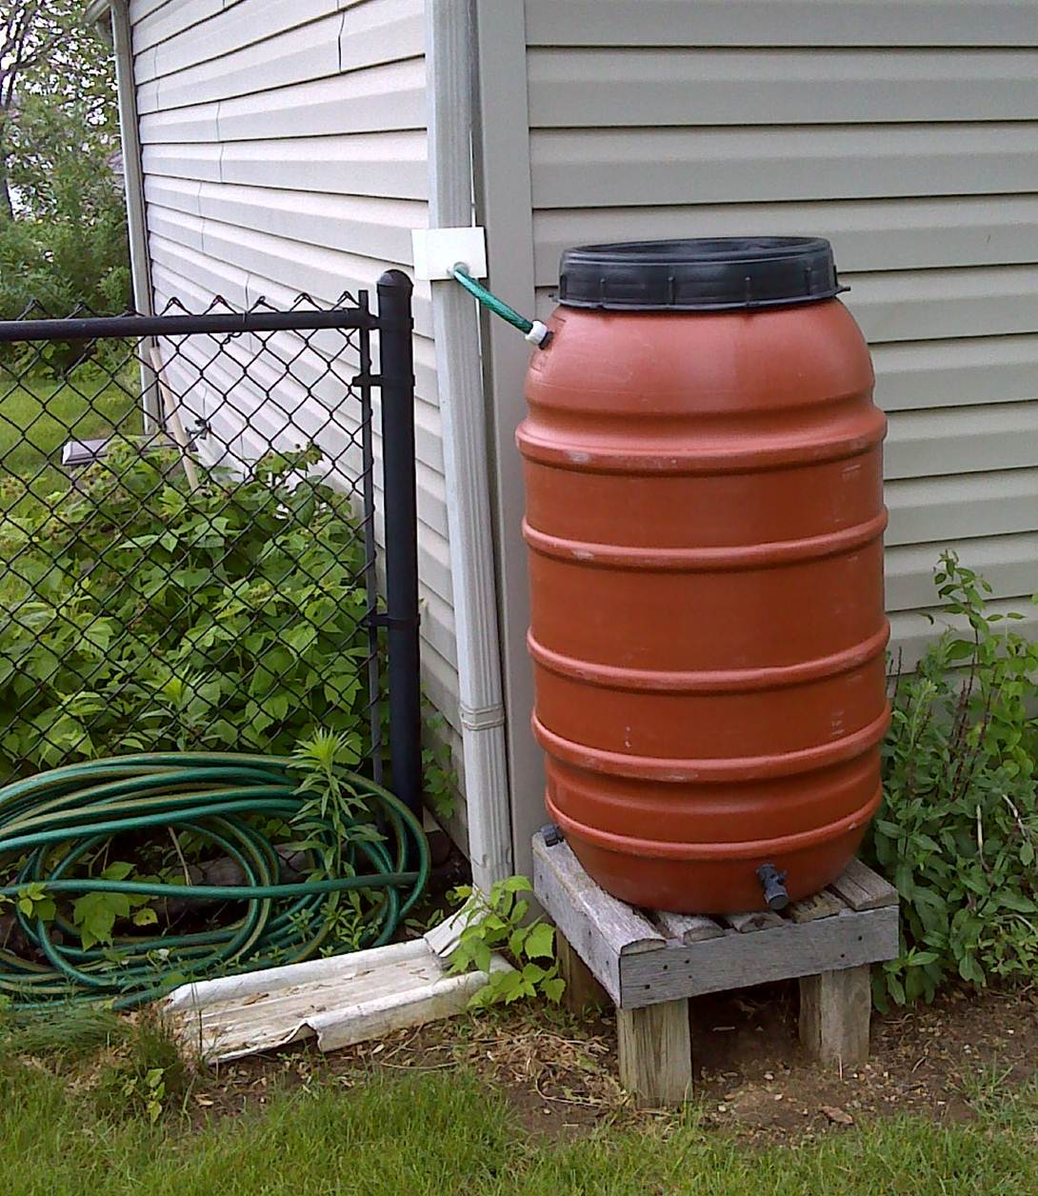
Rain barrels

Slide 10
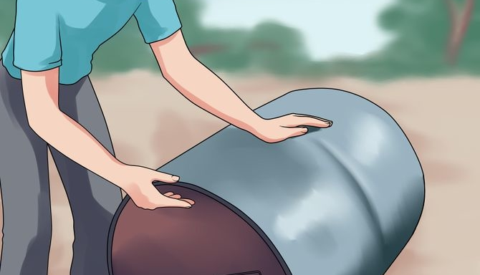
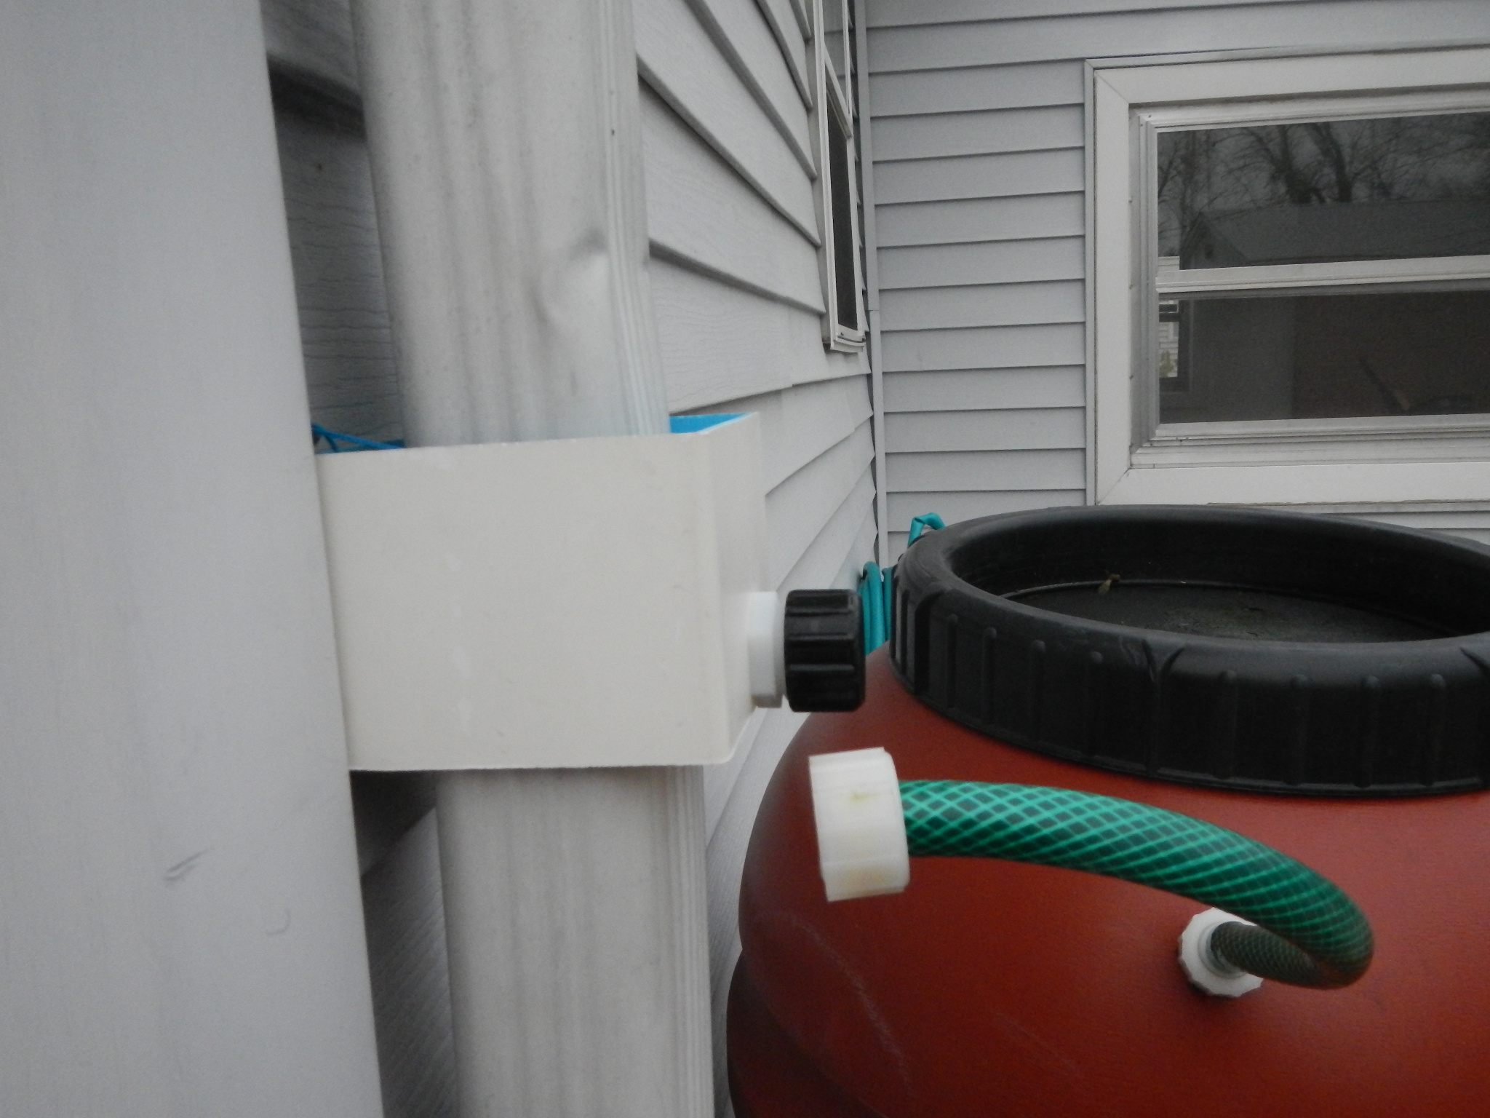
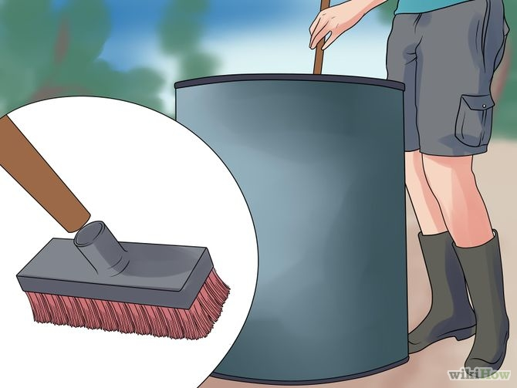
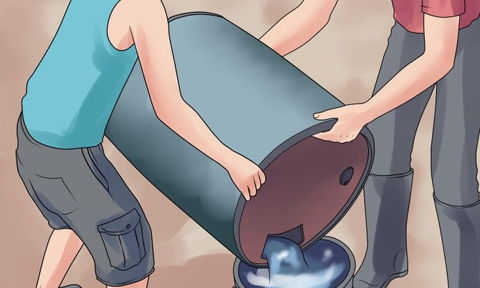
Rain barrels

Slide 11
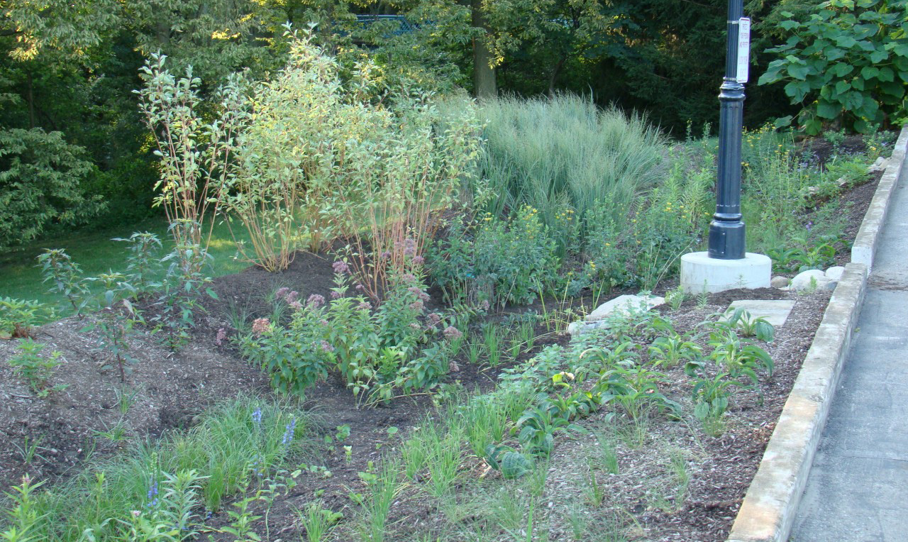
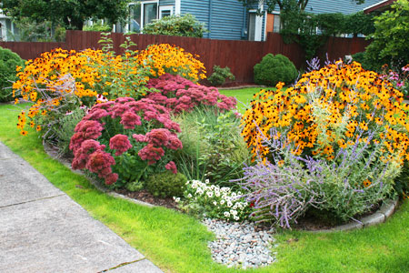
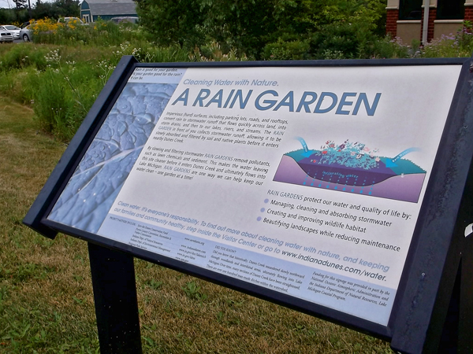
Rain gardens

Slide 12
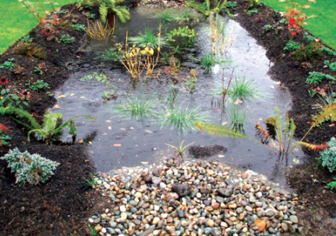
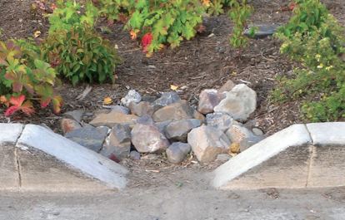
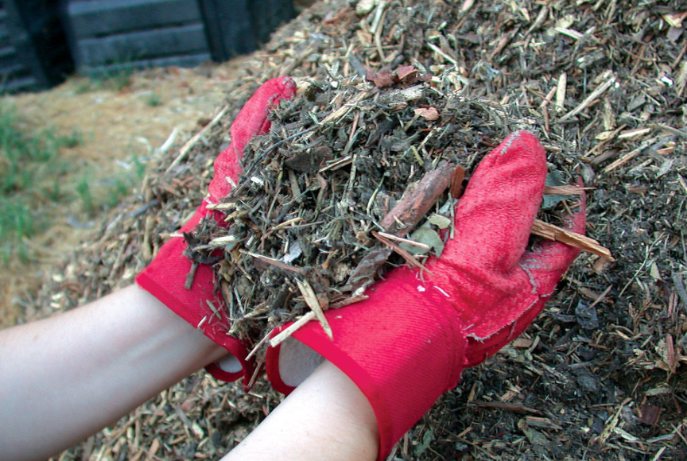
Rain gardens

Slide 13
What’s next?
Share with Extension, watershed groups
Distribute to public!

